Slide 1



Análise de Desempenho de Vendas de Lojas de Varejo
View in Power BI
Last data refresh:
16/12/2024 15:03:51 UTC
Downloaded at:
16/12/2024 15:06:04 UTC

Slide 2
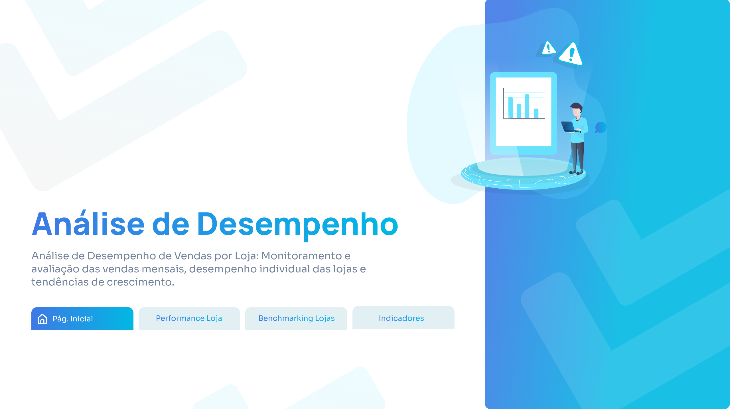
Capa
Notes:
actionButton
No alt text provided
actionButton
No alt text provided
actionButton
No alt text provided

Slide 3
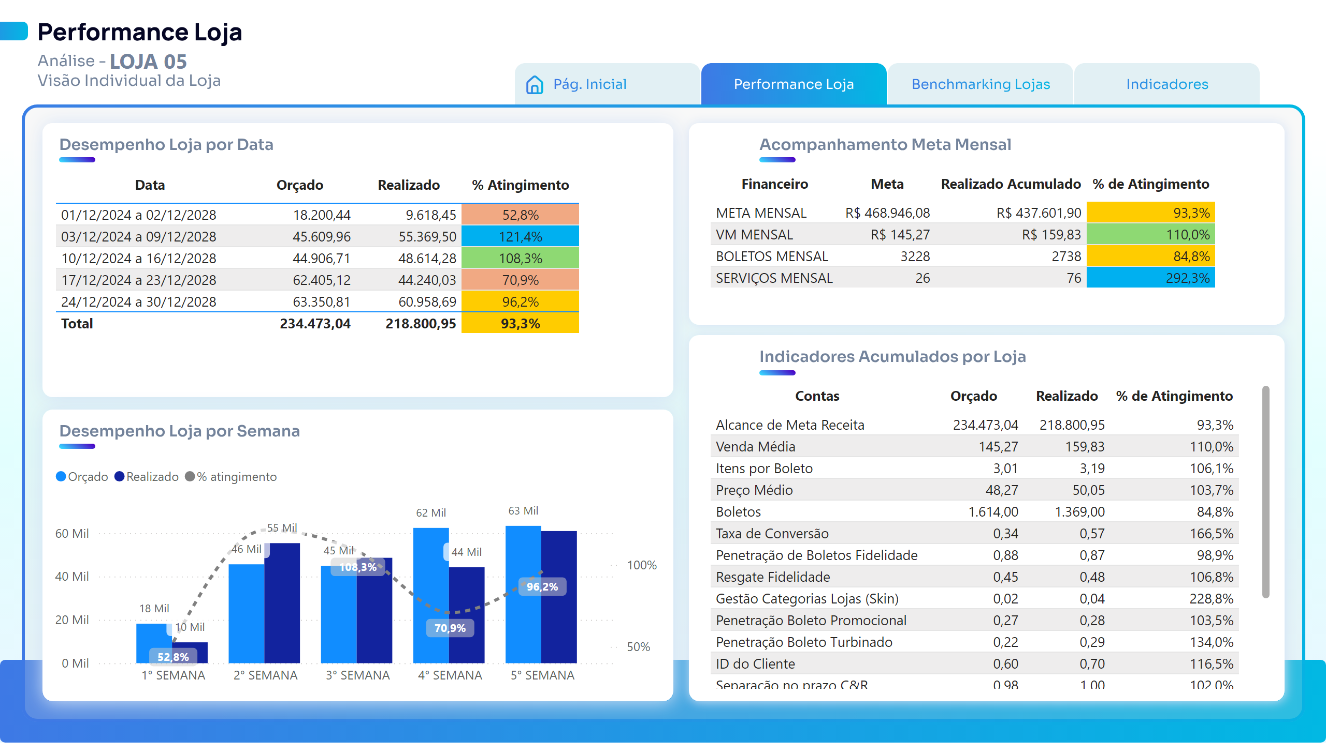
Performance Loja
Notes:
tableEx
No alt text provided
lineClusteredColumnComboChart
No alt text provided
actionButton
No alt text provided
card
No alt text provided
tableEx
No alt text provided
actionButton
No alt text provided
tableEx
No alt text provided
actionButton
No alt text provided

Slide 4
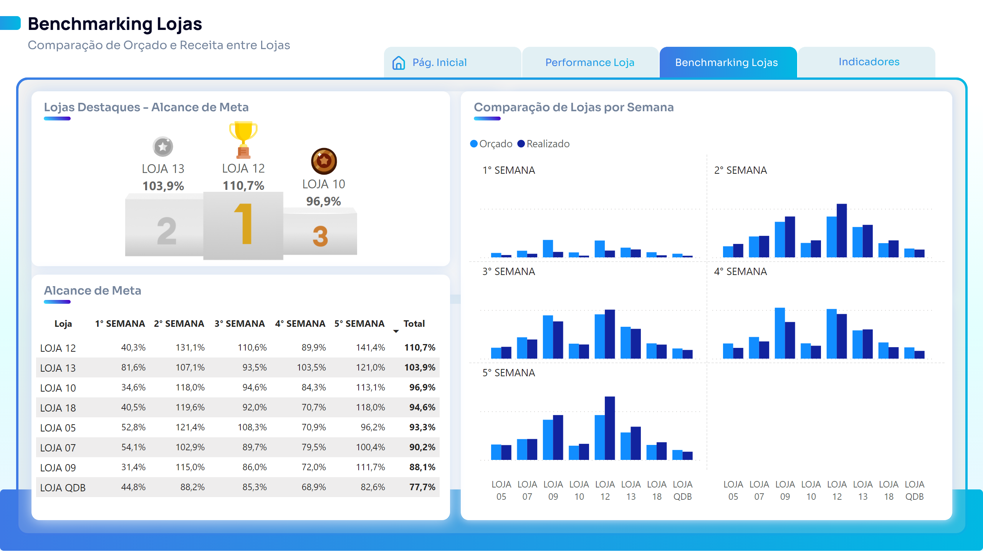
Benckmarking - Lojas
Notes:
pivotTable
No alt text provided
clusteredColumnChart
No alt text provided
actionButton
No alt text provided
actionButton
No alt text provided
actionButton
No alt text provided
cardVisual
No alt text provided
cardVisual
No alt text provided
cardVisual
No alt text provided
image
No alt text provided
image
No alt text provided
image
No alt text provided

Slide 5
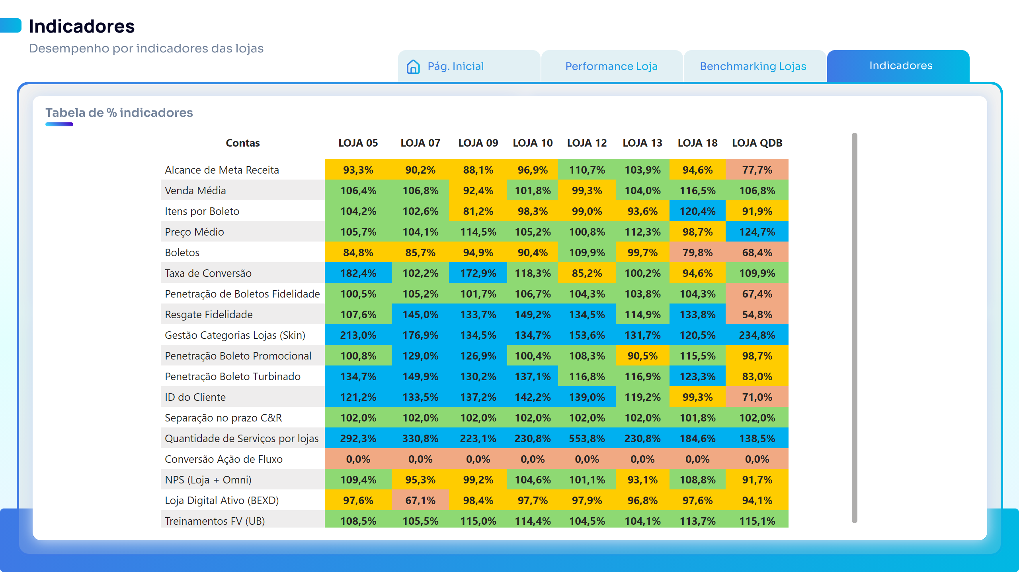
Indicadores
Notes:
pivotTable
No alt text provided
actionButton
No alt text provided
actionButton
No alt text provided
actionButton
No alt text provided

